Slide 1
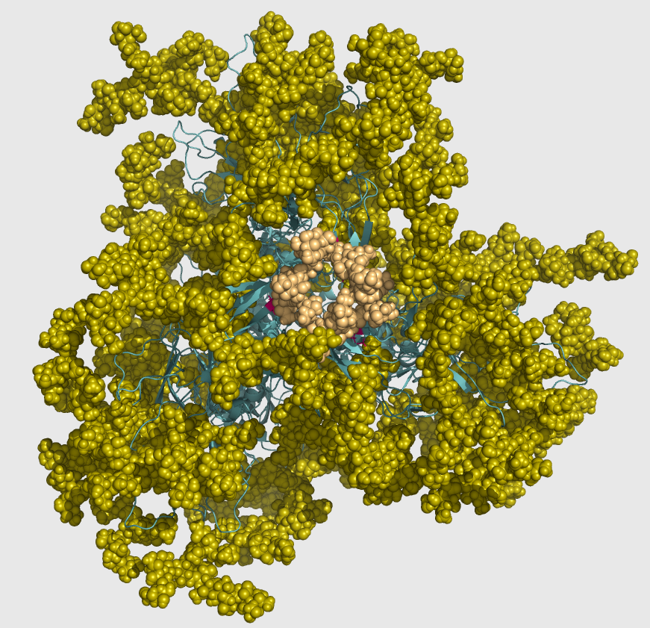
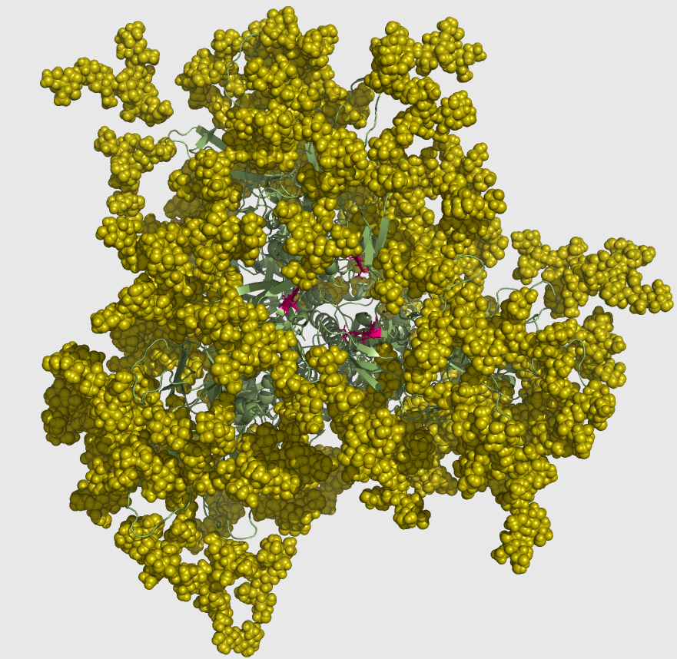
Investigating the effects of glycosylation at N160 site on HIV Envelope trimer stability and antigenicity
Modestas Filipavicius
7/11/2016

Slide 2
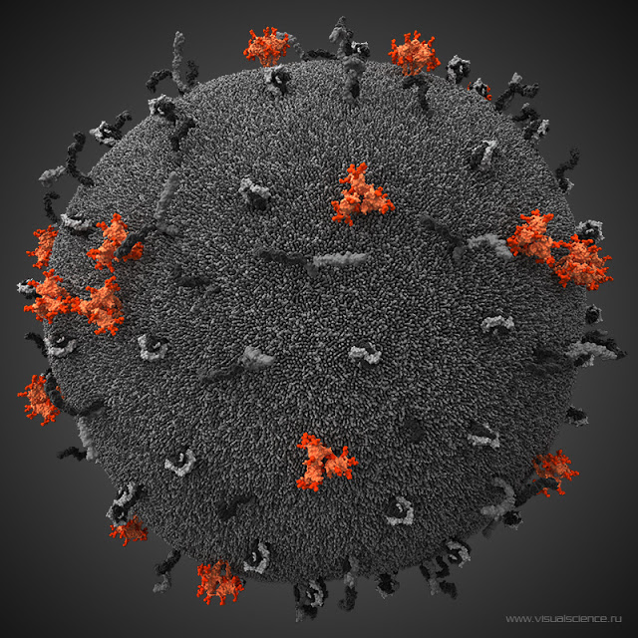
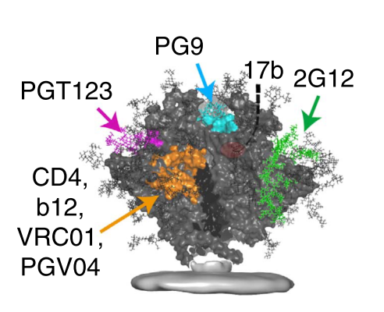
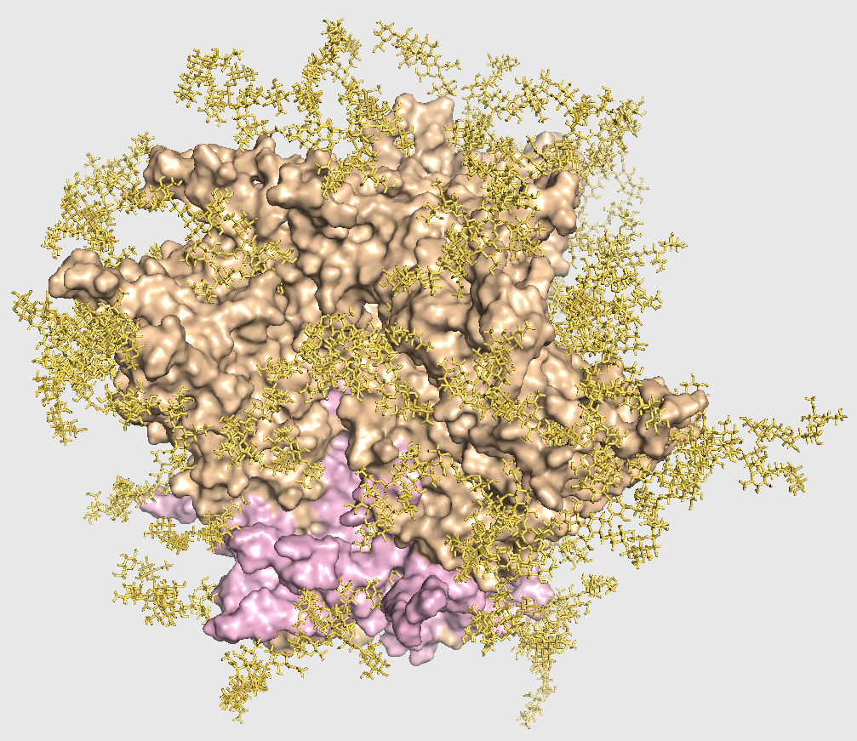
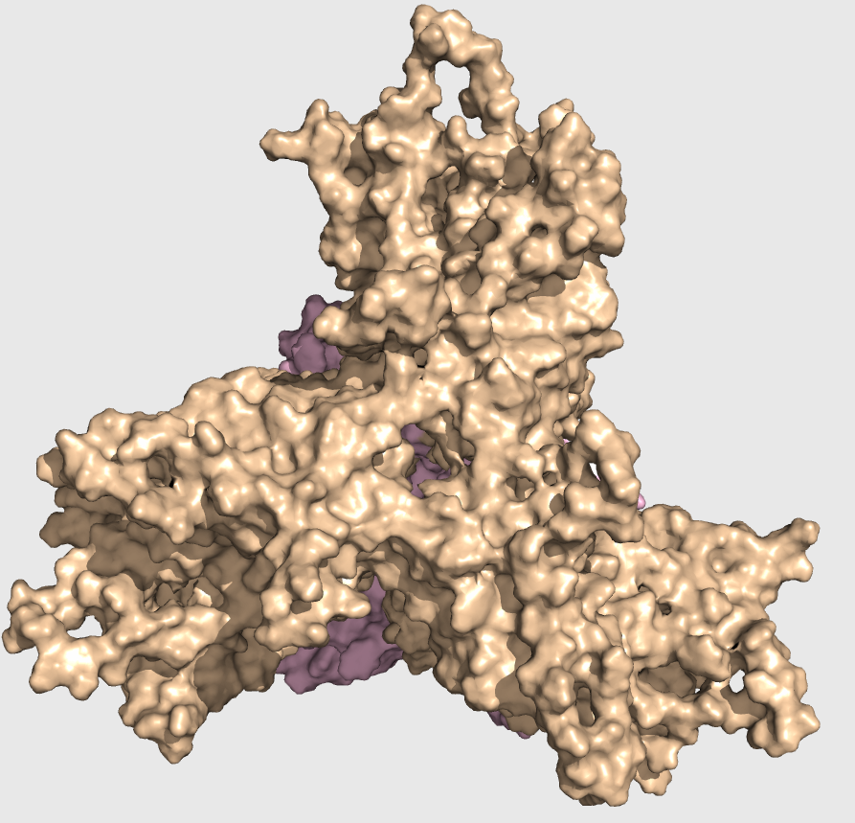
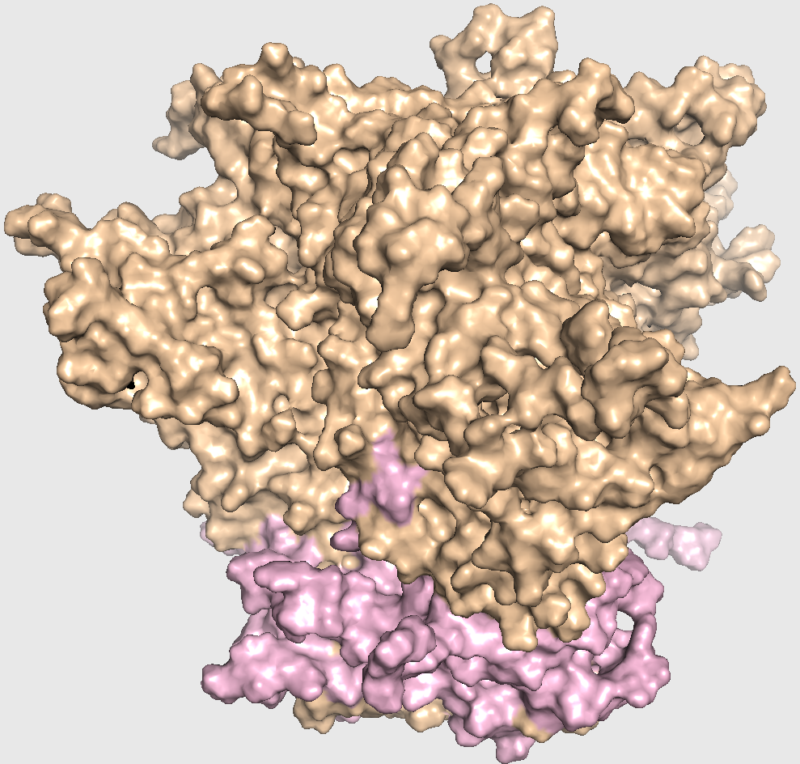
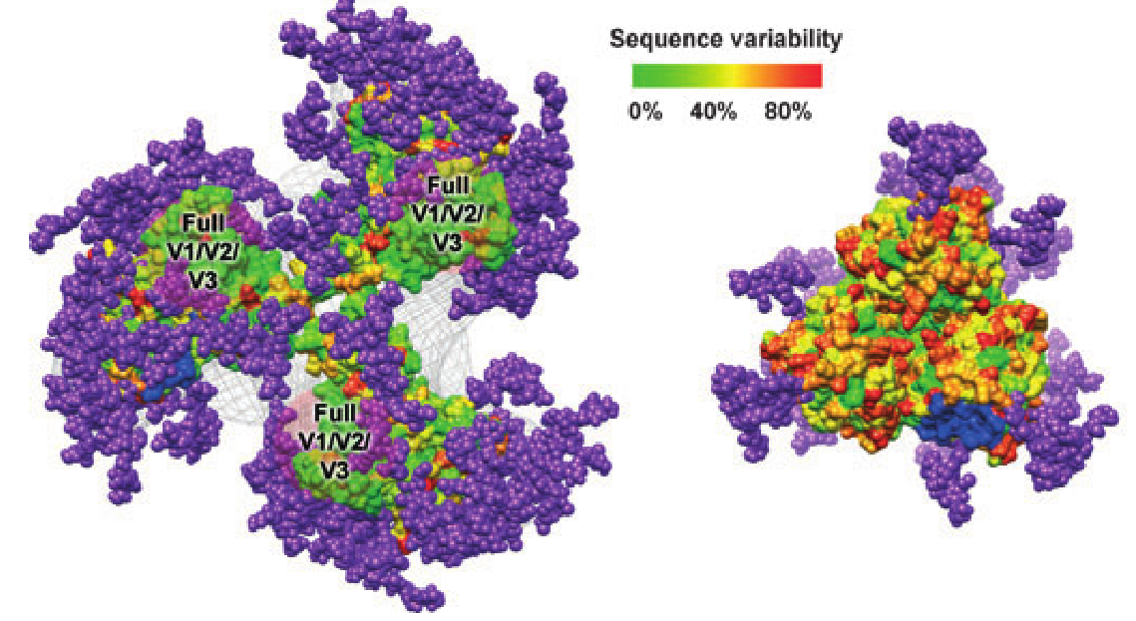
HIV Env glycoprotein – vaccine design target
Envelope trimer (Env) as immunogen and vaccine candidate:
Elicits broadly neutralizing antibodies (bNAbs)
bNAbs will bind and neutralize HIV
Trimer of protomers
gp120 (wheat)
gp41 (light pink)
Env is hidden from bNAbs by glycan shield (40% mass)
Varying glycosylation patterns w/ 80 Glycans
Some NAbs recognize glycan epitopes
Vaccine design aim: Recognizing and stabilizing vulnerable Env conformations
Native-like Env model – KNH1144 w/ SOSIP modifications:
No TMD
Extra disulfides between gp41-gp120
adapted from Guttman et al., 2015
Julien et al., 2012
Notes:
Env is sole target for nAbs -> we need bnAbs elicited that can neutralize many isolates to get an HIV vaccine
However, today’s Vaccine candidates have low potency and breadth or cannot elicit nAbs at all.
Glycans modulate immune response.
Three copies of gp120+gp41 form a trimer

Slide 3
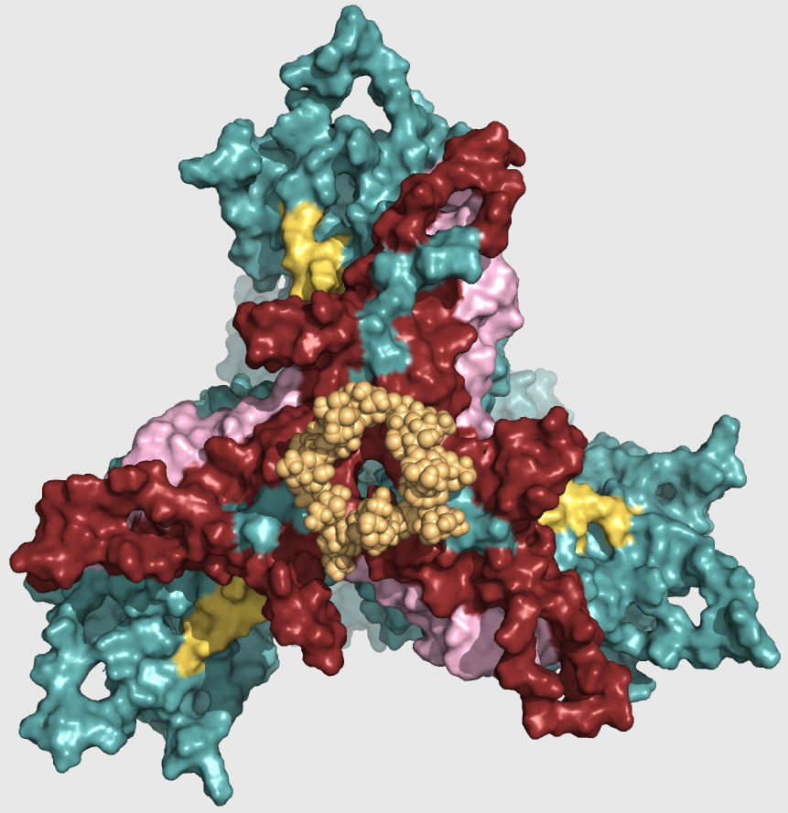
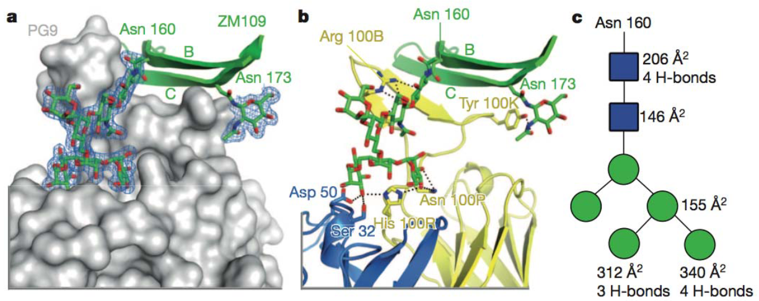
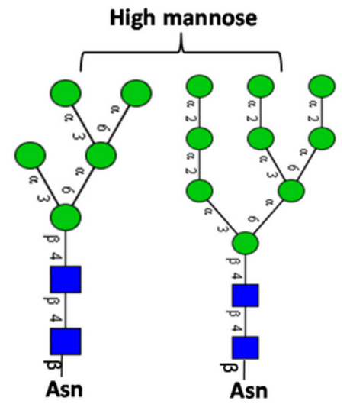
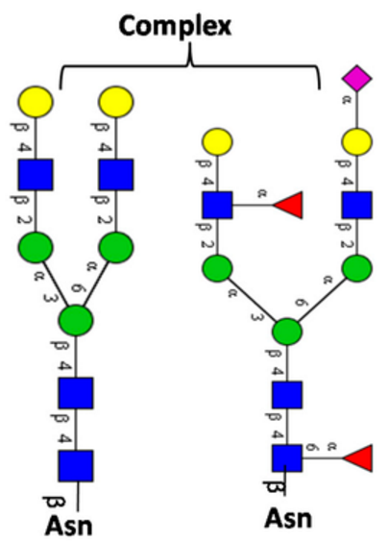
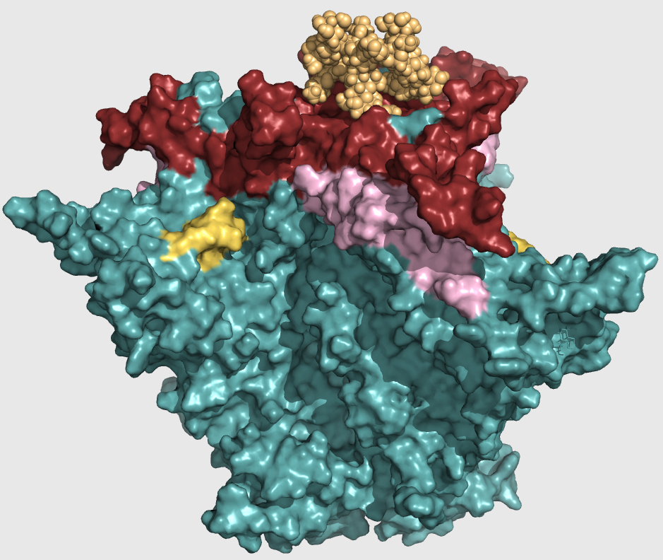
N160 glycan is found at V1/V2 interface
V1/V2 is most variable region – escapes immune recognition
K160N (6% prevalence) increases viral infectivity 4-times!
N160 is targeted by PG9-like antibodies
McLellan et al., 2012
Notes:
gp120 has 5 variable loops (V1-V5);
Square is N-acetyl glucosamine – GlcNAc, yellow – galactose, triangle -fucose
N160 is oligomannose
11 H‐bonds and 1,150 Å of surface area are buried in the PG9‐N160 interface
Substituting to N is advantageous, hiding trimer interface epitope with sugar

Slide 4
How important is N160 glycan for trimer stability and neutralizing antibody binding?

Slide 5
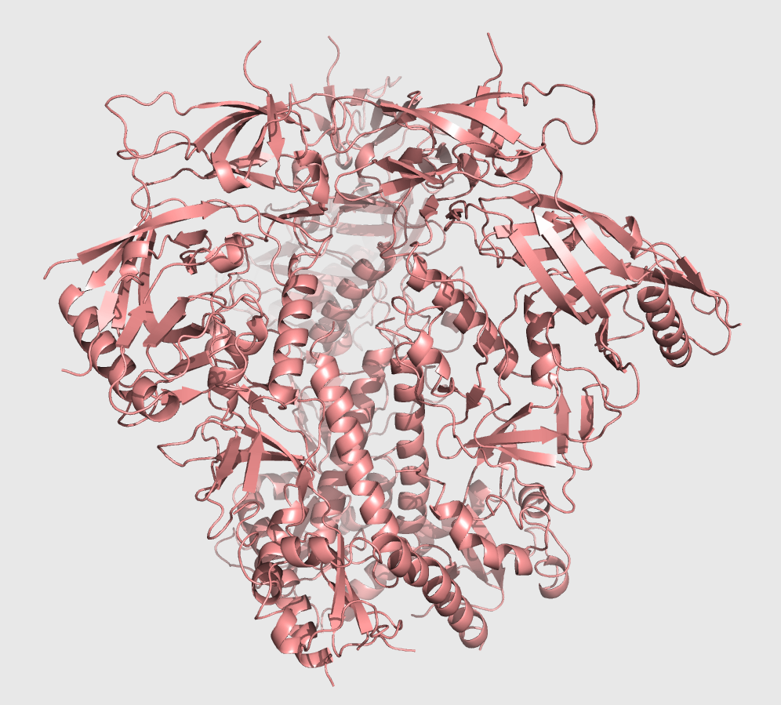
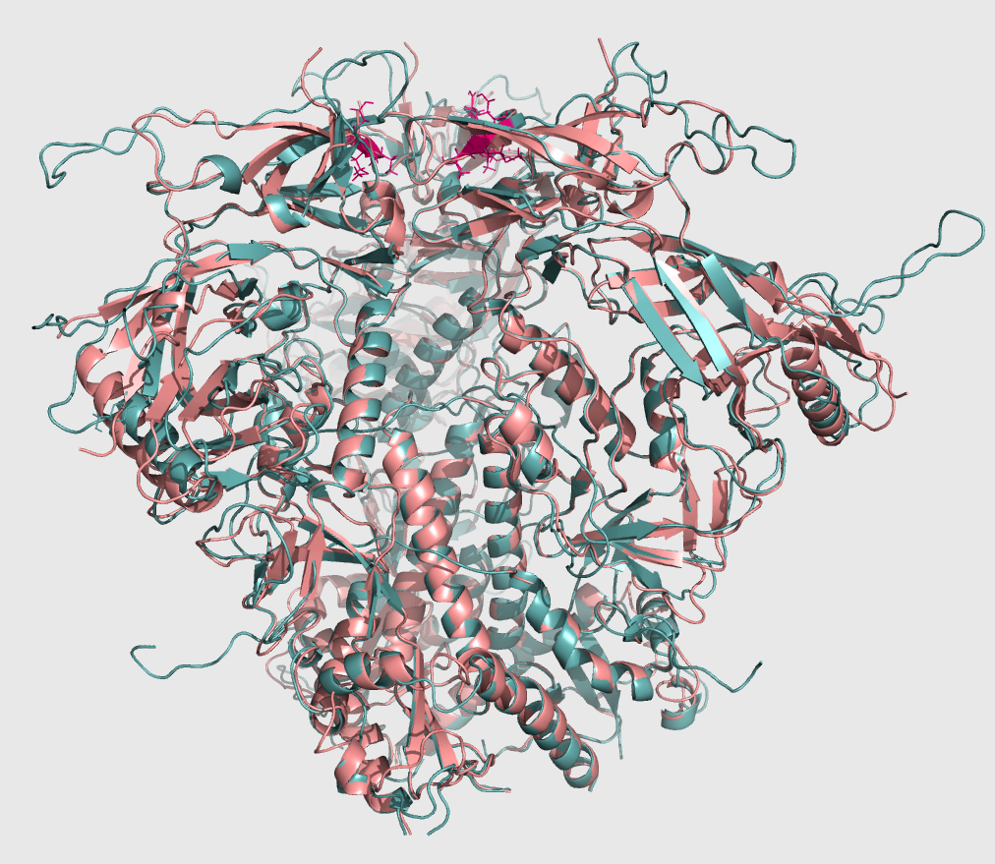
Problem: no KNH1144 structure
BG505 Xtal
KNH1144 model
Notes:
Visualize biological problem: what happens when a single glycan is removed?
model from single existing structure – template is bg595 xtal, target – knh1144 fasta
Restored mostly variable loops, 50 aa from 600

Slide 6
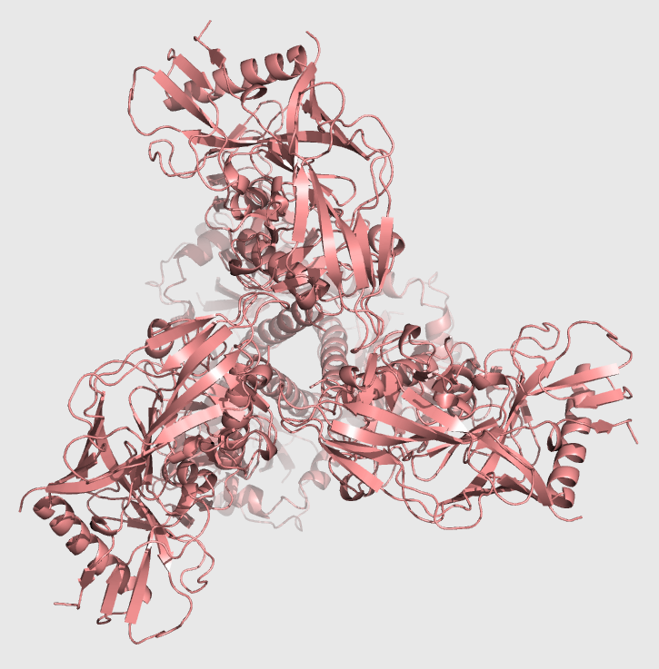
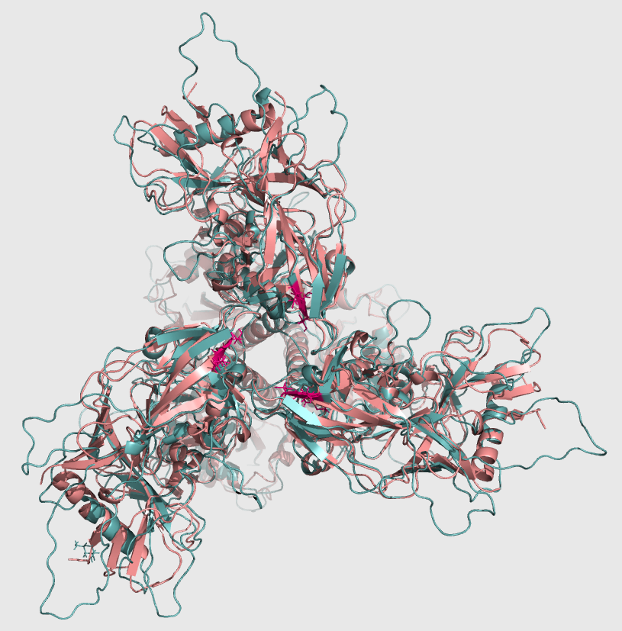
Homology Modeling with Modeller
BG505 Xtal
KNH1144 model

Slide 7
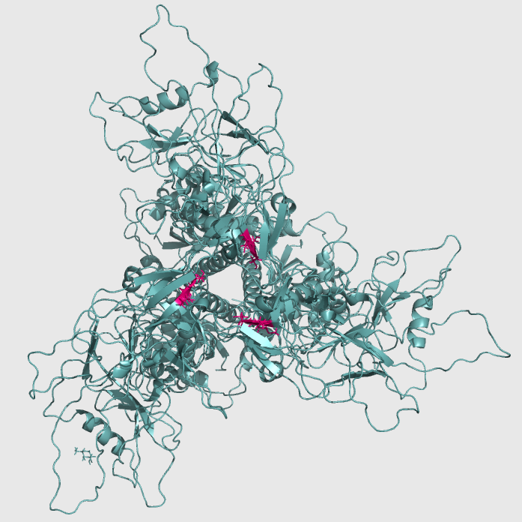
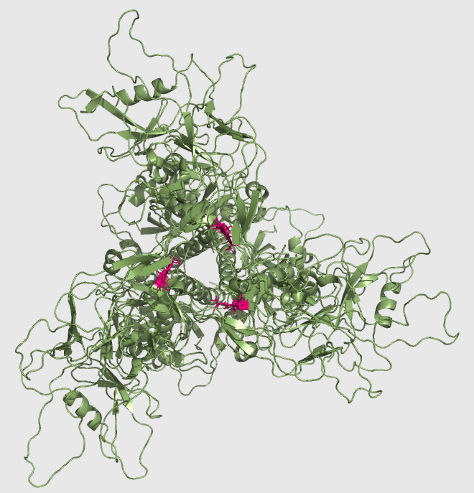
Models for WT and MT KNH1144 Env structures
w/ N160 glycosylation site
w/out N160 glycosylation site
Notes:
I got the homoly model for KNH114

Slide 8
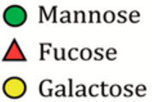
Removing N160 glycan exposes trimer apex w/ conserved residues
w/ N160 GLYCAN
w/out N160 GLYCAN
Notes:
Virus developed glycan to mask epitope with conserved sequences! Mutation to glyc is advantageous
80 glycs restored, N160 is Man 8,9
Modeling Glycans (AllosMod)
Still with modeller – Andrej Sali; from several configurations, not all high mannose
Man 5 – High mannose
Man 5-9, 8-9, 5-8, 8, complex (we used).
HHOOK -> TEST THIS MODEL. LET’S PRODUCE PROTEIN

Slide 9
Outline
KNH1144 Env Expression and Purification
Biophysical characterization:
Dynamic Light Scattering (DLS)
Thermal stability
Negative Stain Electron microscopy (EM)
Small Angle X-ray Scattering (SAXS)
Antigenicity characterization
Bio-Layer Interferometry (BLI)
Notes:
WE HAVE IDEA HOW OUR STRUCTURAL BIOLOGY LOOKS LIKE – IT’S WORTH MAKING THE PROTEINS!
..and STUDY BIOPHYS AND ANTIG

Slide 10
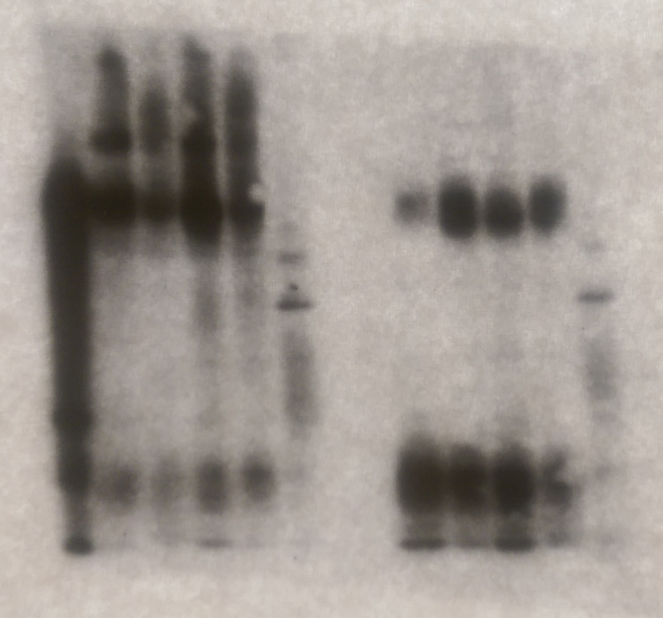
Recombinant expression of KNH1144 SOSIP.644 construct
- DTT
+ DTT
HEK293F cell line
Human PTMs
Complex glycans
6-day transfection
Notes:
Cleavage happened: 140 was gleaved into gp120 and gp140

Slide 11
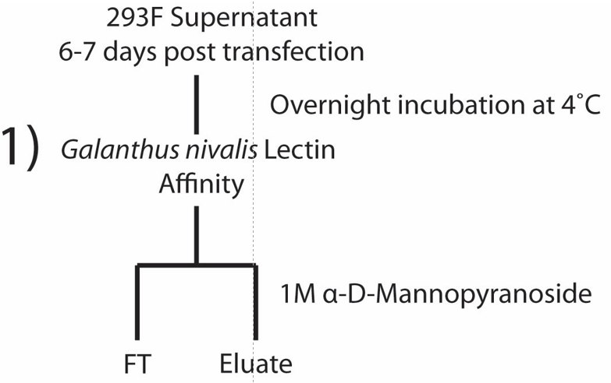
One-step purification is not enough
TRIMER
DIMER/MONOMER
VOID
Verkerke et al., 2016 (in press)
Notes:
Snowdrop lectin – binds glycosylated proteins, eluted in high [sugar]

Slide 12
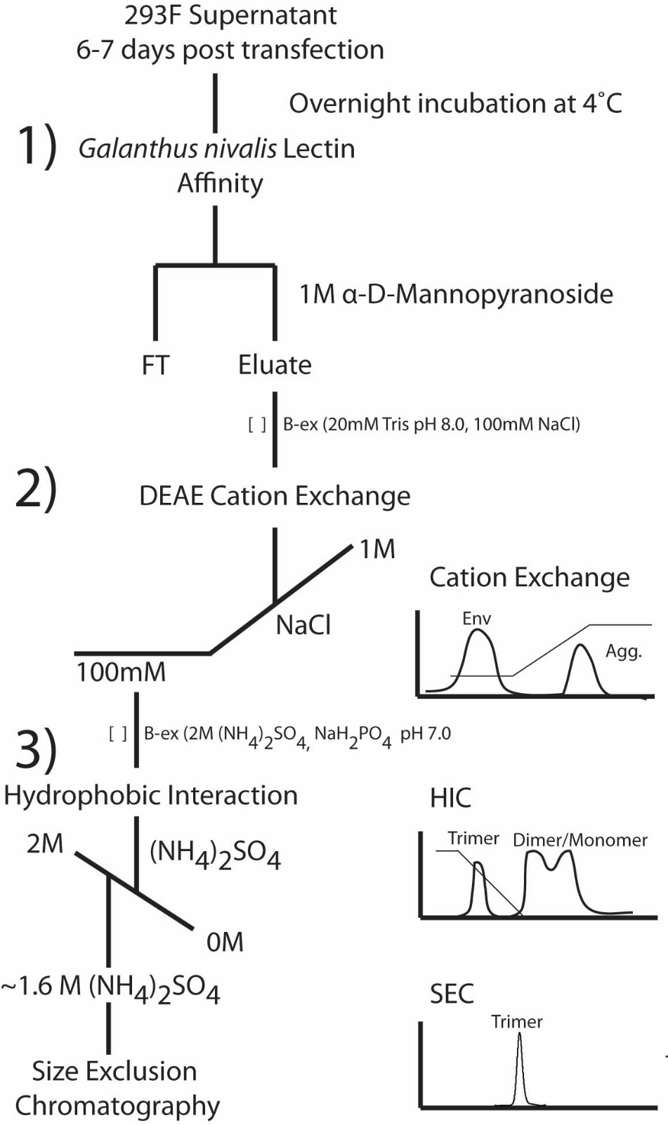
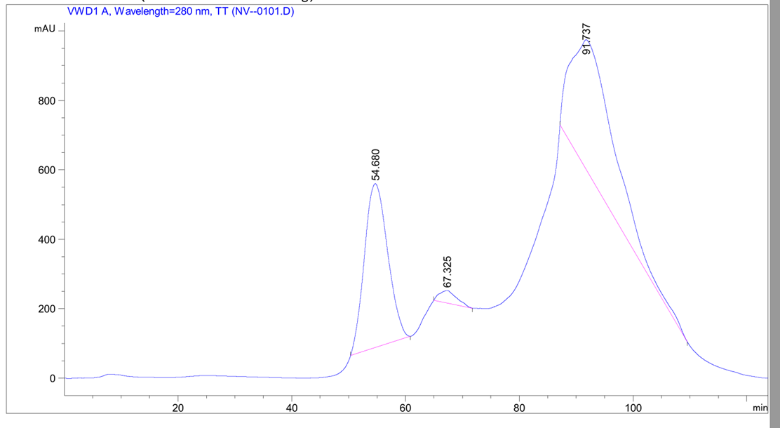
New epitope-independent purification method
Traditional purification with mAbs which bind quaternary epitopes (2G12, PGT145)
Here we select for biochemical features, not antigenic
Notes:
Snowdrop lectin – binds glycosylated proteins, eluted in high [sugar]
Cation exchange – captures misfolded and aggregated protomers which have a pI>7.5, and bind to (-) resin. Flow through is monomers, dimers, trimers
Hydrophobic int chrom -

Slide 13
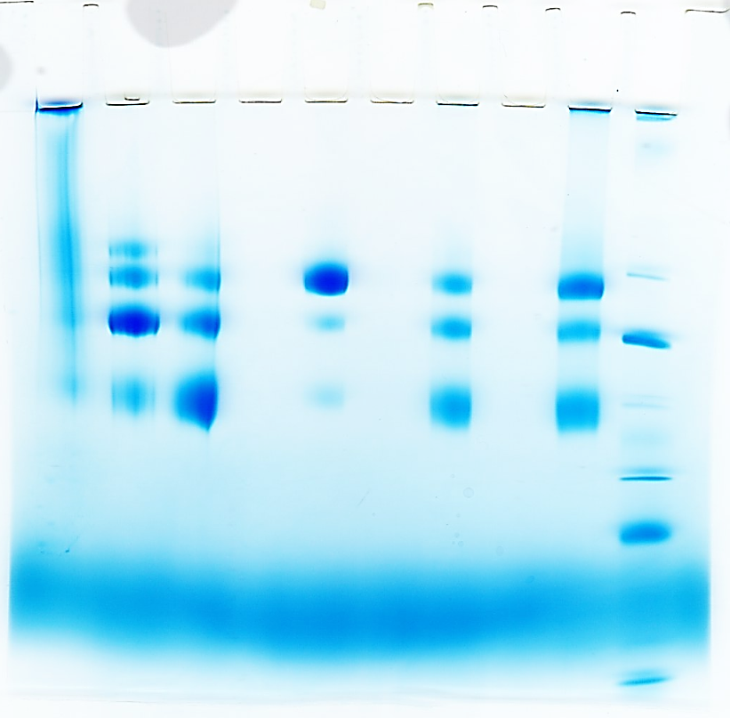
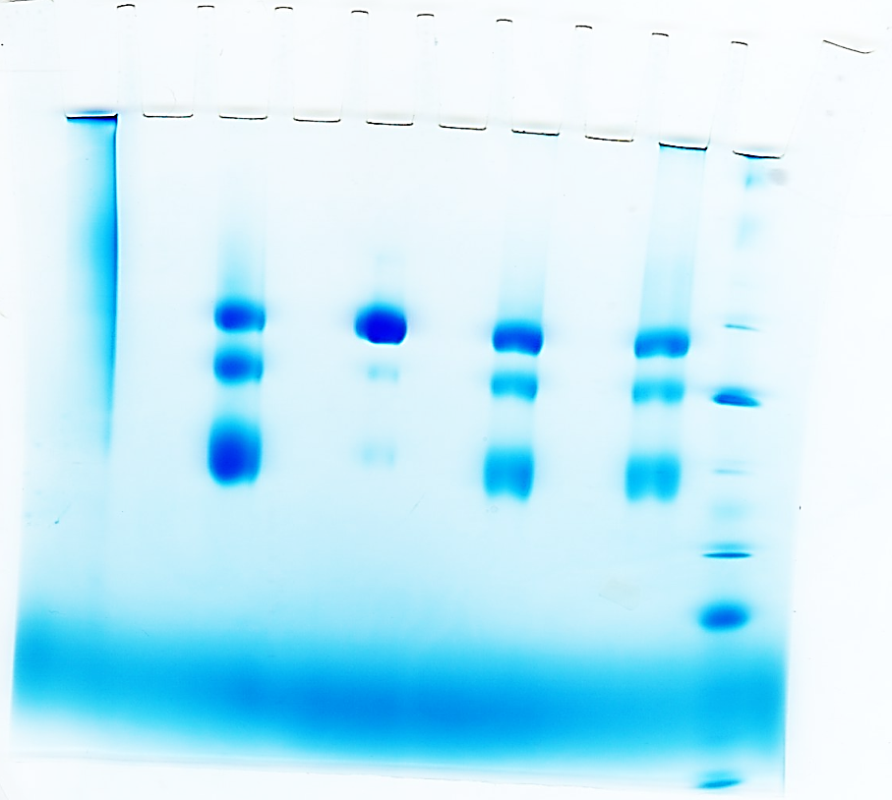
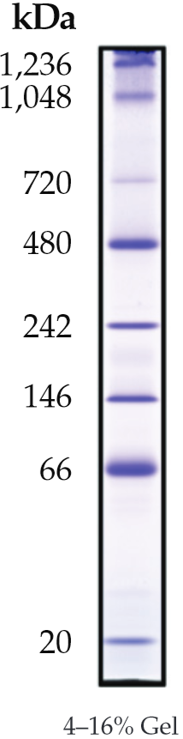
Native-PAGE: Four step purification produces 95% pure trimer
- IEX elution
- NativeMark
- HIC 62-75
- HIC 65-108
- IEX elution
- HIC
- HIC 76-106
- NativeMark
- GNL
- IEX
- GNL
- IEX
- HIC
KNH1144 SOSIP w/out N160 Glyc
KNH1144 SOSIP w/ Glyc
Notes:
Final yield 1-2mg /L

Slide 14
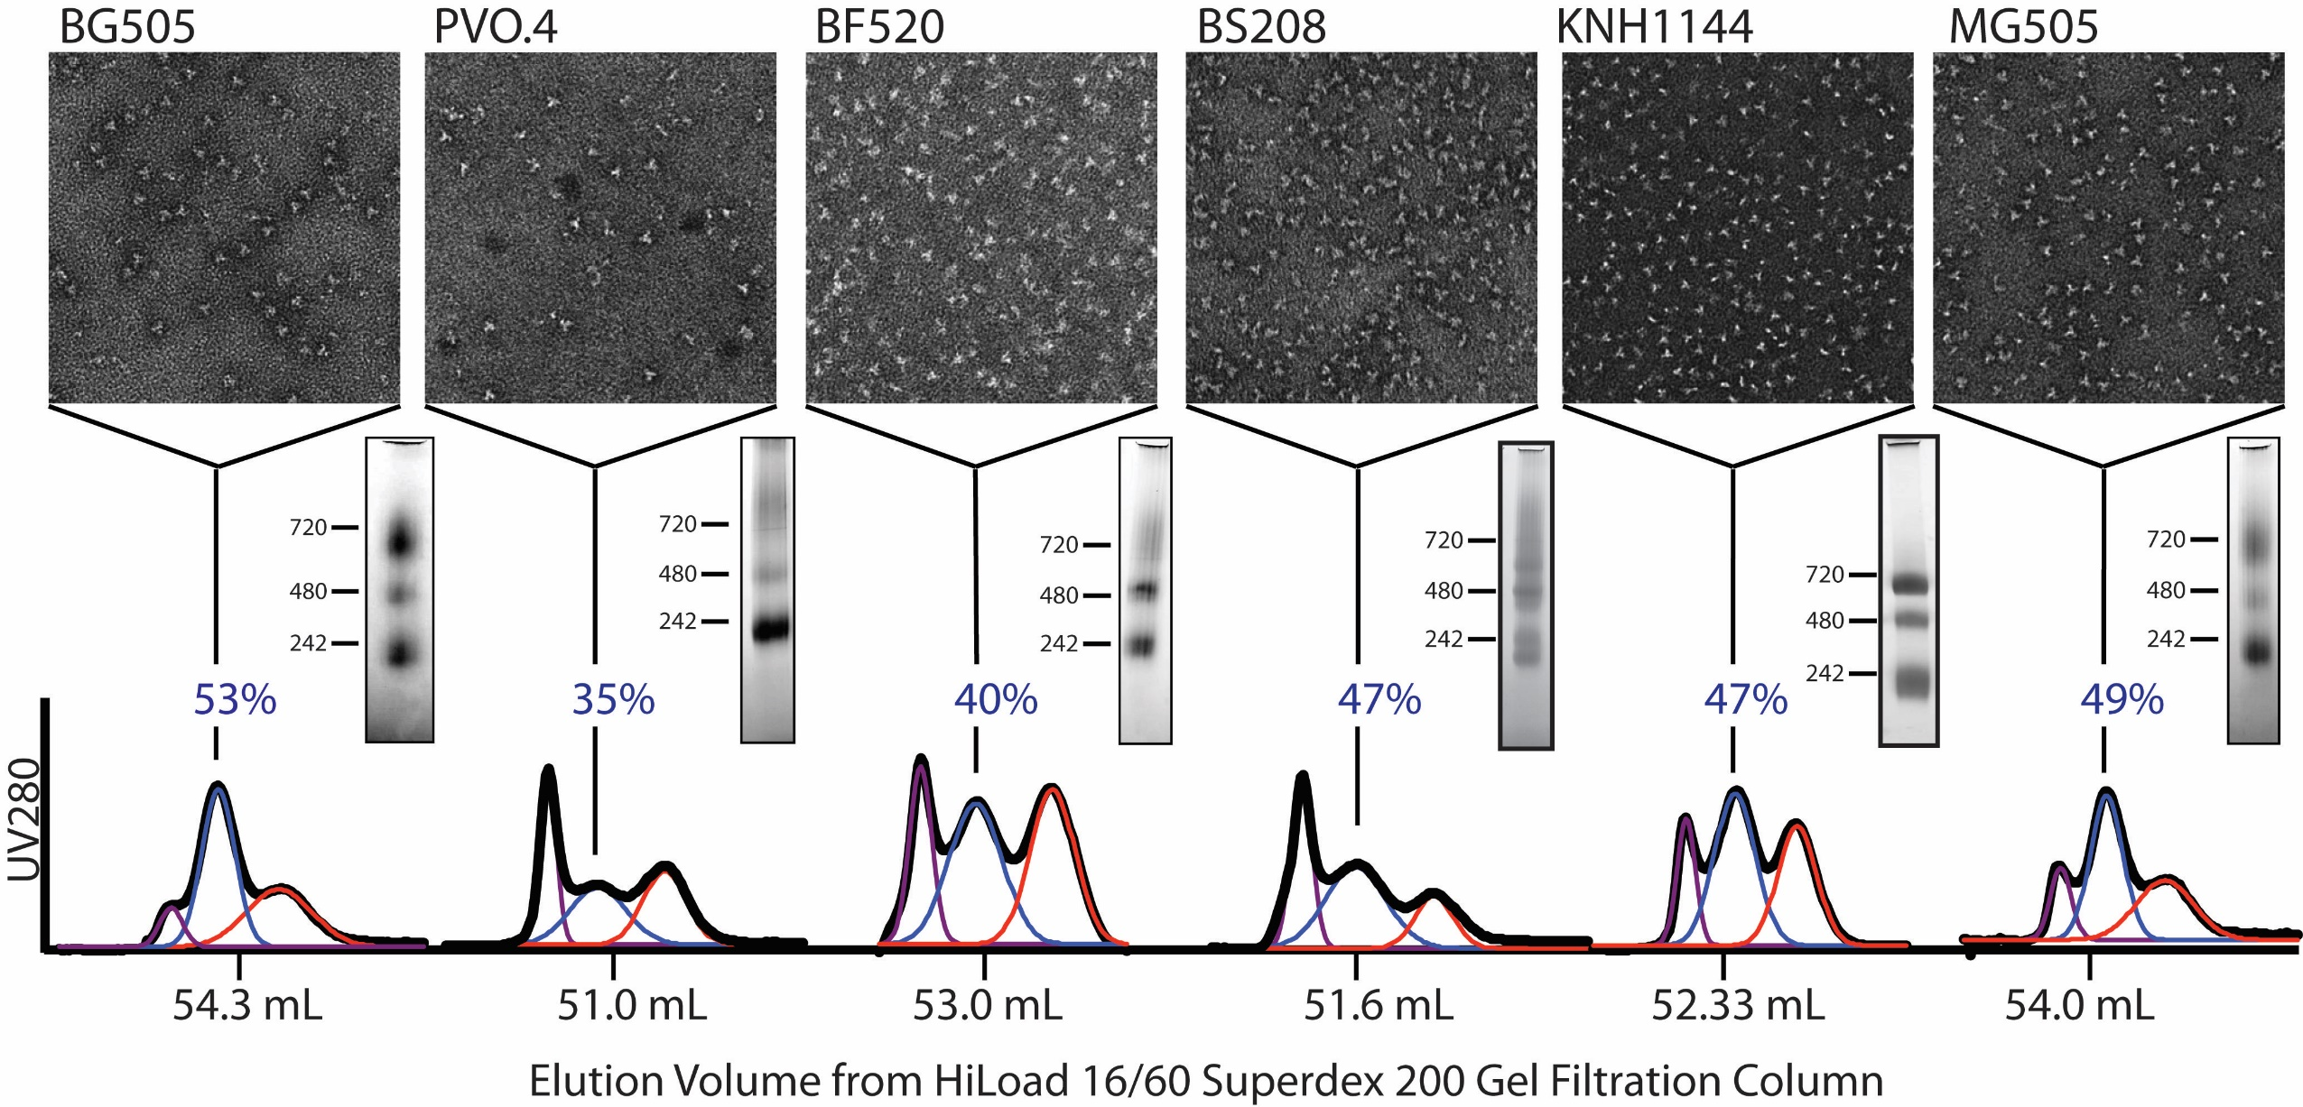
Purification method works for other isolates too!

Slide 15
Outline
Glycosylated KNH1144 SOSIP Env homology model
Expression and Purification
Biophysical characterization:
Negative Stain Electron microscopy (EM)
Dynamic Light Scattering (DLS)
Thermal stability
Small Angle X-ray Scattering (SAXS)
Antigenicity characterization
Bio-Layer Interferometry (BLI)
Notes:
SEEING PROTEIN ON A GEL IS NOT ENOUGH. Validate that protein is stable with biophysical tools and that it binds antibodies correctly

Slide 16
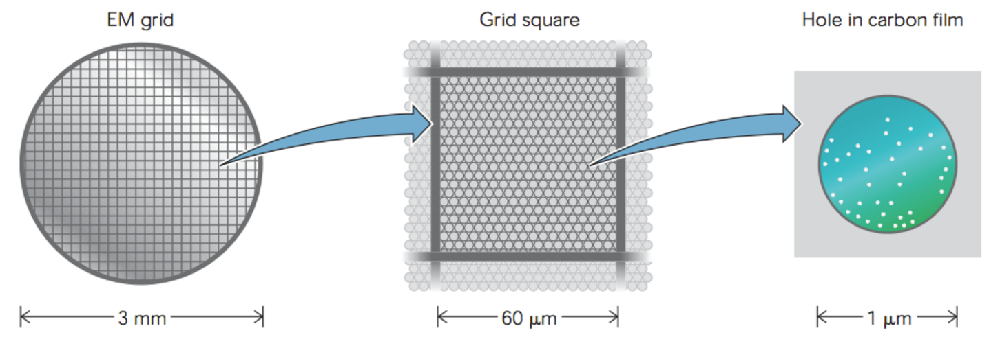
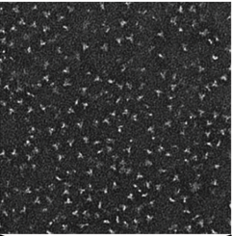
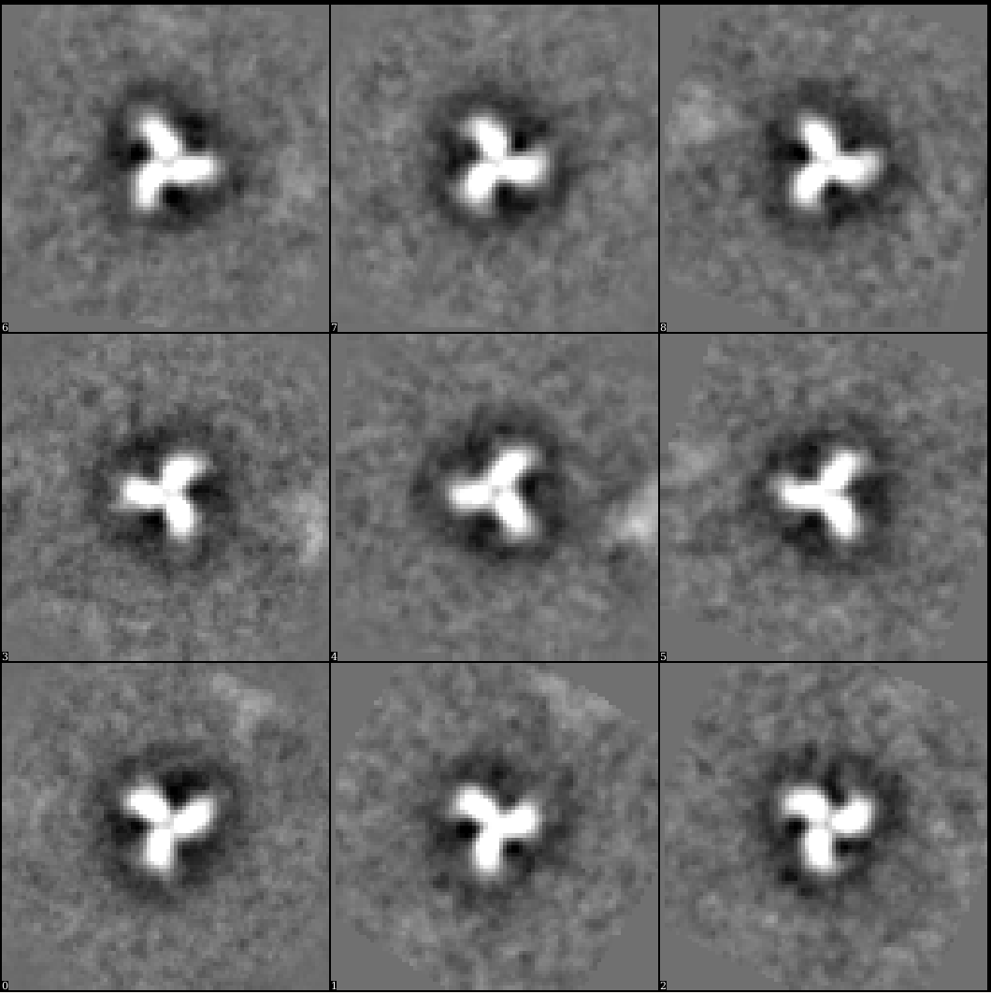
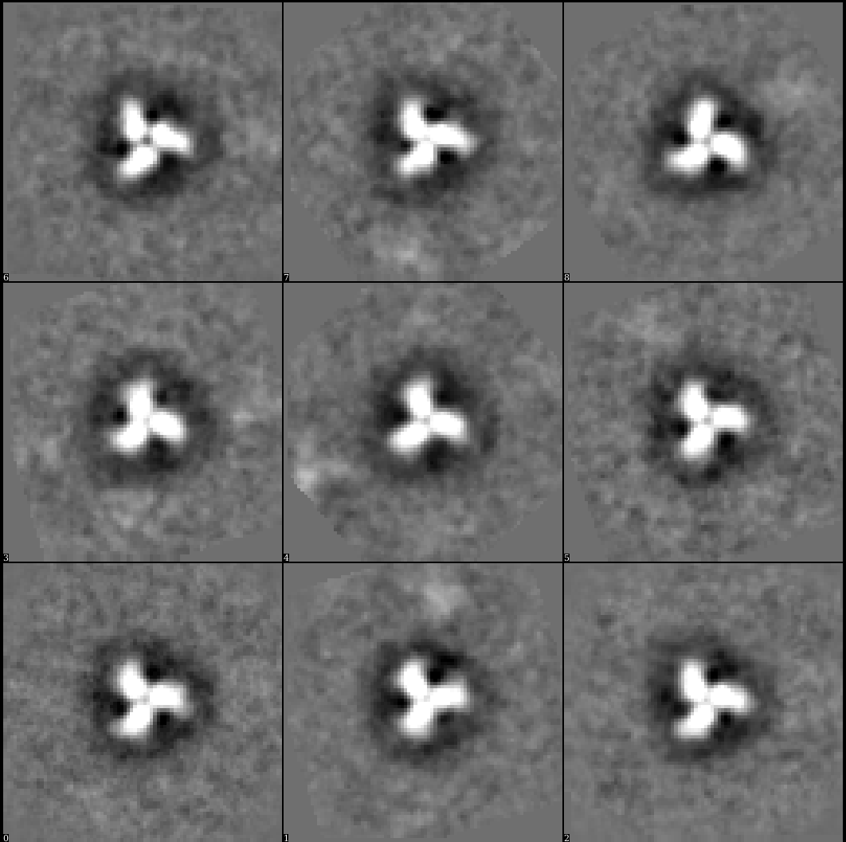
Negative stain EM
High contrast
Uses little protein
3 uL at 30 ug/mL
Carbon-coated grids (C-flat)
Tungsten stain (Nano-W)
T12 TEM at 120 keV
50,000 mag
Particle picking
Well-formed trimers!
w/ N160 glycan
w/out N160 glycan
Notes:
nano-W (2% methylamine tungstate, Nanoprobes), 3 mm -> 0.06 – 0.1 um grid square
Picked with EMAN
CONTRAST - stain absorbs electrons in higher amounts than the surrounding medium. Therefore, different regions of the sample have different electron densities and can be differentiated easier in the resulting projections

Slide 17
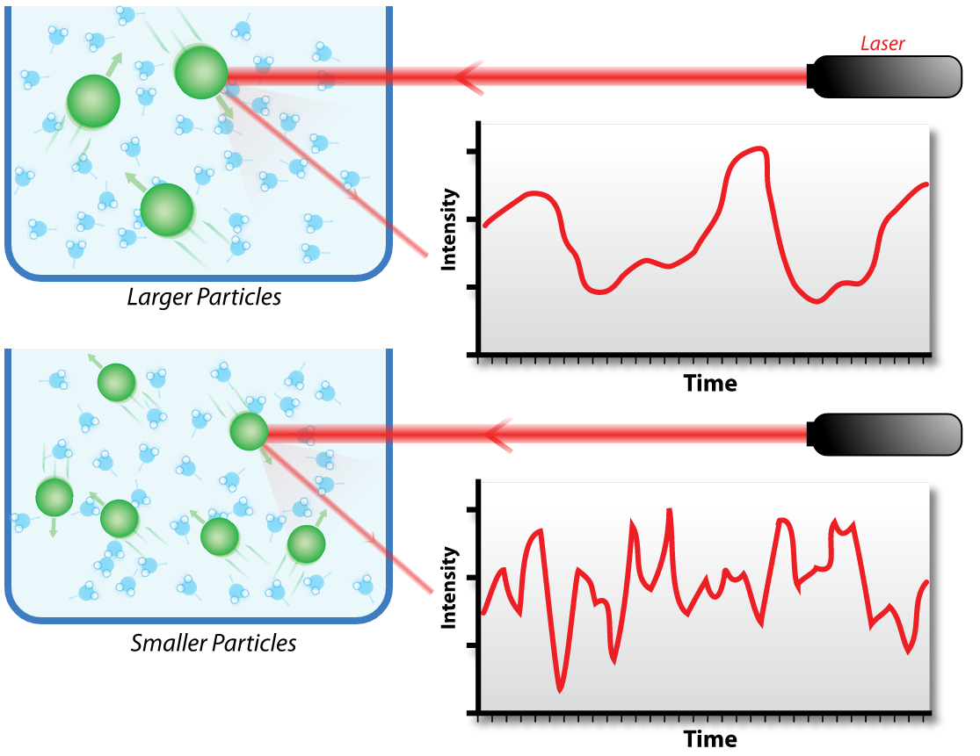
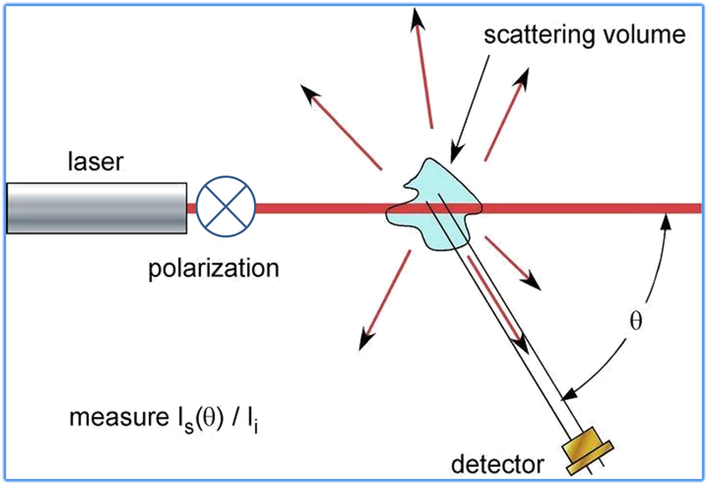
Dynamic Light Scattering
Rayleigh scattering for particles
< 250 nm
Scattering intensity fluctuates over time due to random particle motion
Estimate for Rhyd, MW and Tm in solution
Notes:
Scattered light ~ concentration. photon auto-correlation function
the autocorrelation function y decays starting from zero delay time, and faster dynamics due to smaller particles lead to faster decorrelation of scattered intensity trace.
hydrodynamic radius (RH) is then calculated from the diffusion coefficient using the Stokes-Einstein equation. Assumed as hard sphere in solution. Gives estimate for apparent size of solvated tumbling molecule
Rg is defined as the mass weighted average distance from the core of a molecule to each mass element in the molecule

Slide 18
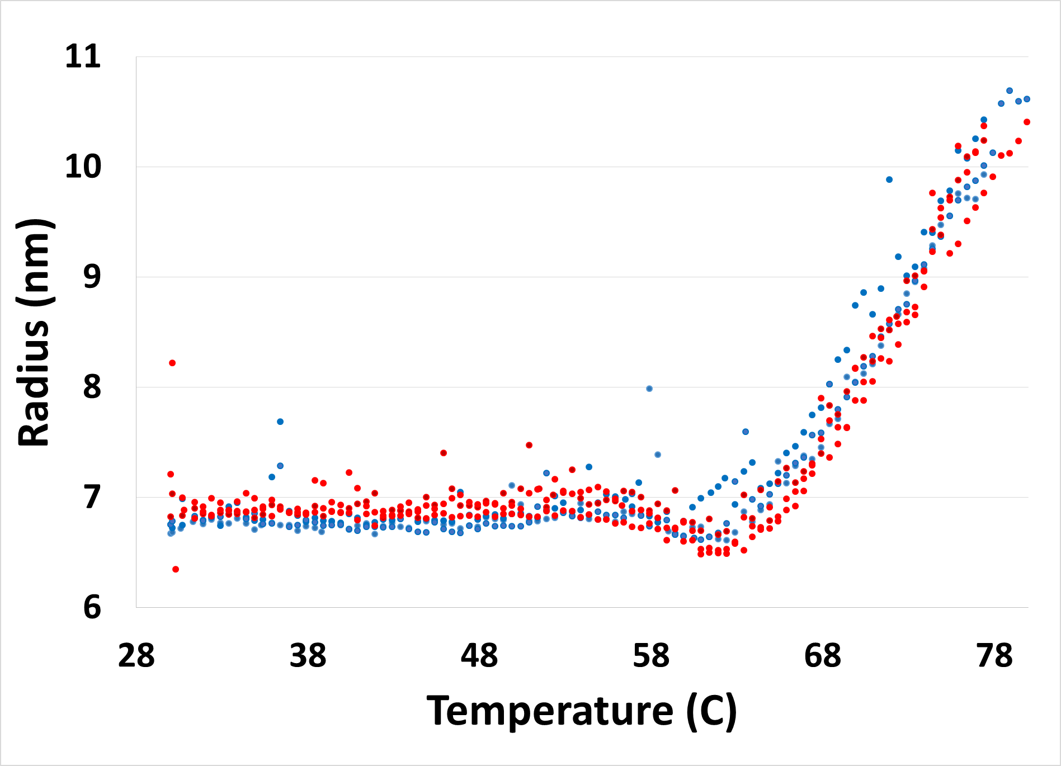
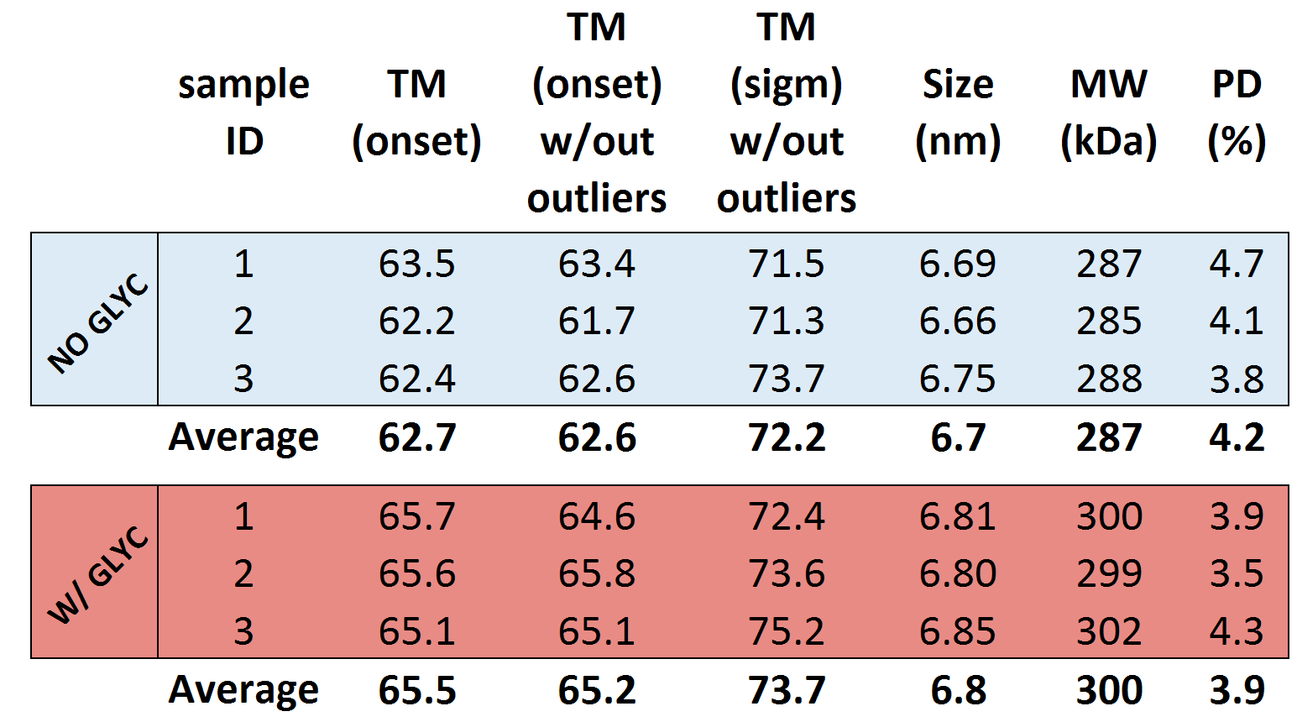
DLS: removing N160 glycan reduces protein stability
Notes:
HYDRODYNAMIC RADIUS – fitting a sphere – could be overestimate, glycans with waters!! Not Rg, which could be obtained from MALS or SAXS
Dynapro Nanostar (Wyatt); protein diluted to 1 mg/mL in PBS, spun down at 17kg for 20 minutes, 10ul quartz cuvette. Rg and pd generated from 40 acquisitions of 5 s at 20 C.
hydrodynamic radius (RH) is then calculated from the diffusion coefficient using the Stokes-Einstein equation. Assumed as hard sphere in solution. Gives estimate for apparent size of solvated tumbling molecule
Rg is defined as the mass weighted average distance from the core of a molecule to each mass element in the molecule
10 ul of parafin added before ramping temp from 30 to 95 at rate of 1C/min to determine the onset of SOSIP melting/aggregation.

Slide 19
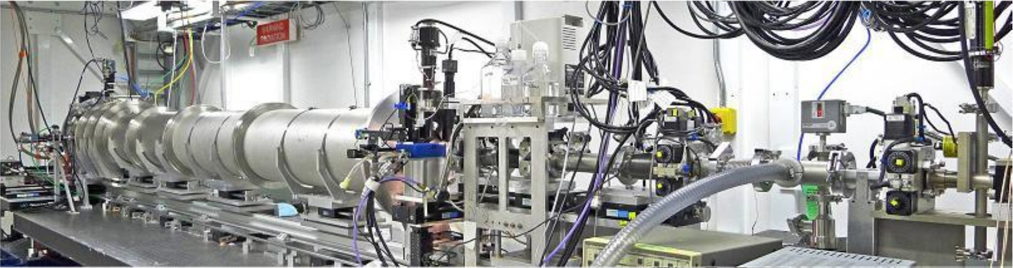
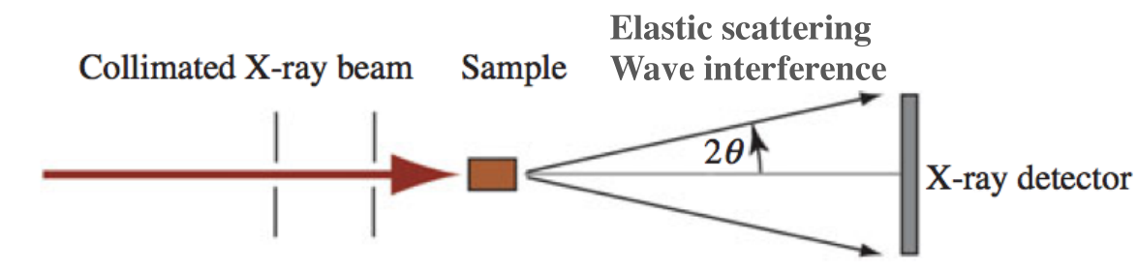
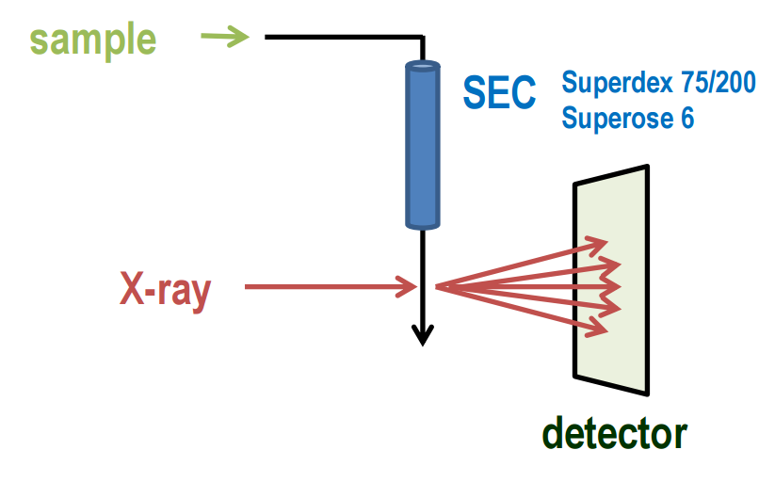
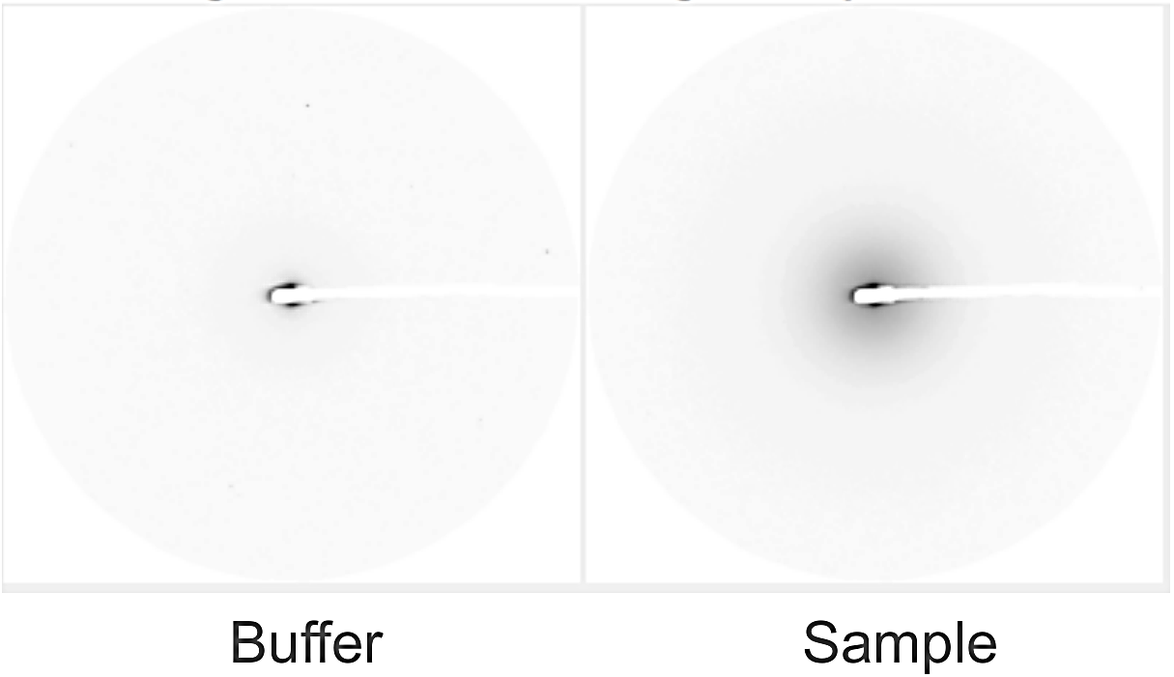
SAXS
Beam Line 4-2 at SSRL
Solution technique, data on:
Assembly state
Conformational changes, flexibility
Size (Rg)
Weight
Shape
SEC-SAXS coupling:
50 uL at 2 mg/mL
600 exposures
Accurate background
subtraction
Notes:
Electrons scatter off protein. Take a difference between sample and buffer scattering signal - > contrast method
q = 4 * Pi * sin(Theta/Lambda) = 2 * Pi * s, s is MOMENTUM TRANSFER (LENGTH OF SCATTERING VECTOR)
Rg is defined as the mass weighted average distance from the core of a molecule to each mass element in the molecule

Slide 20
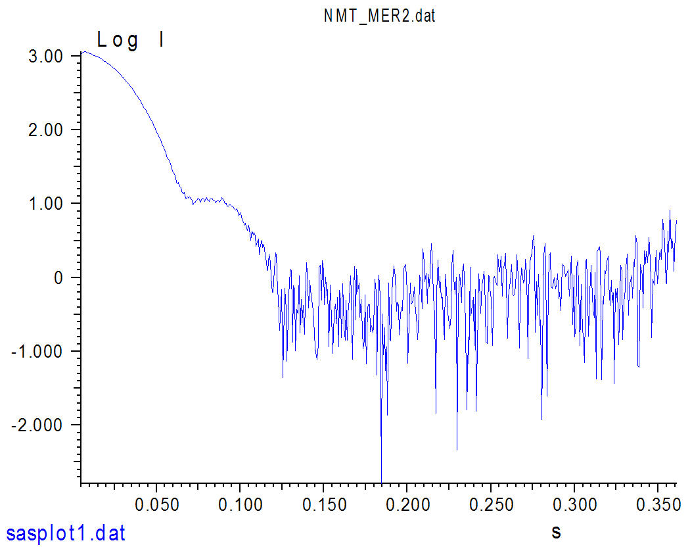
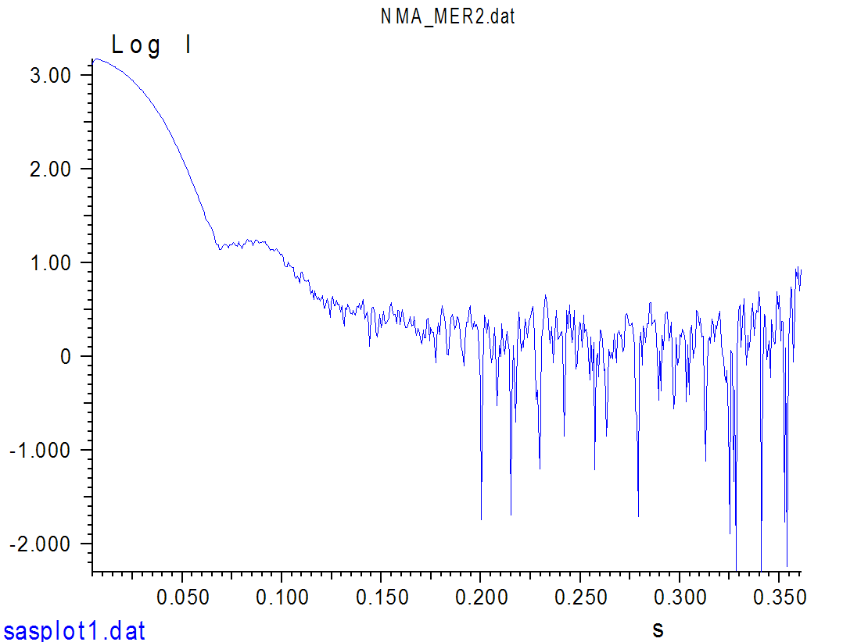
SAXS: Scattering intensity curves
W/ N160 GLYCAN
W/OUT N160 GLYCAN
Notes:
q = 4 * Pi * sin(Theta/Lambda) = 2 * Pi * s, s is MOMENTUM TRANSFER (LENGTH OF SCATTERING VECTOR)
I(0) is intensity measured at 0 angle (q=0), here it’s s, represents number of electrons in the scatterer, unaffected by particle shape and good for MW determination
At high q values -> shape info. It is critical that the plot be linear in the q range of q less than q_{max}=M/R_{g}, where q_{max} is the upper q end-point of Guinier plot and M is typically 1.3 for globular protein.

Slide 21
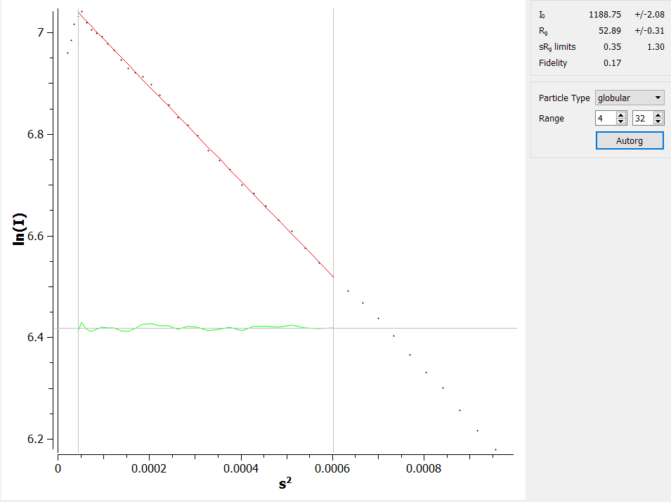
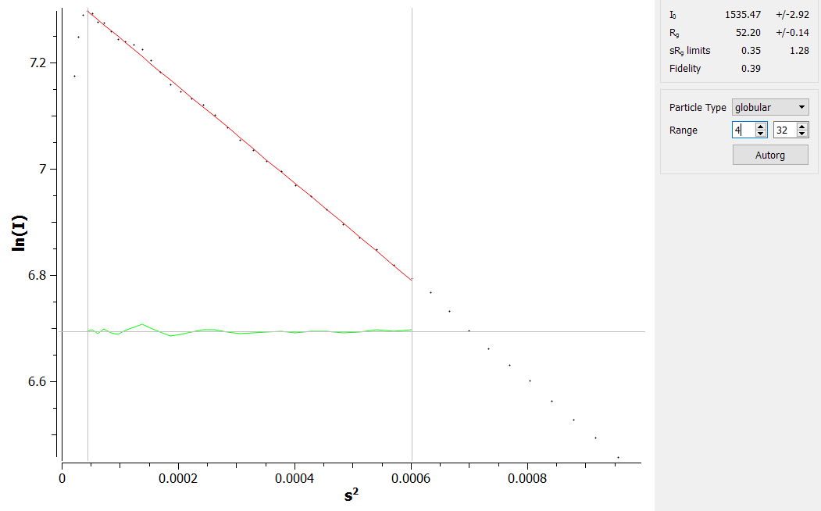
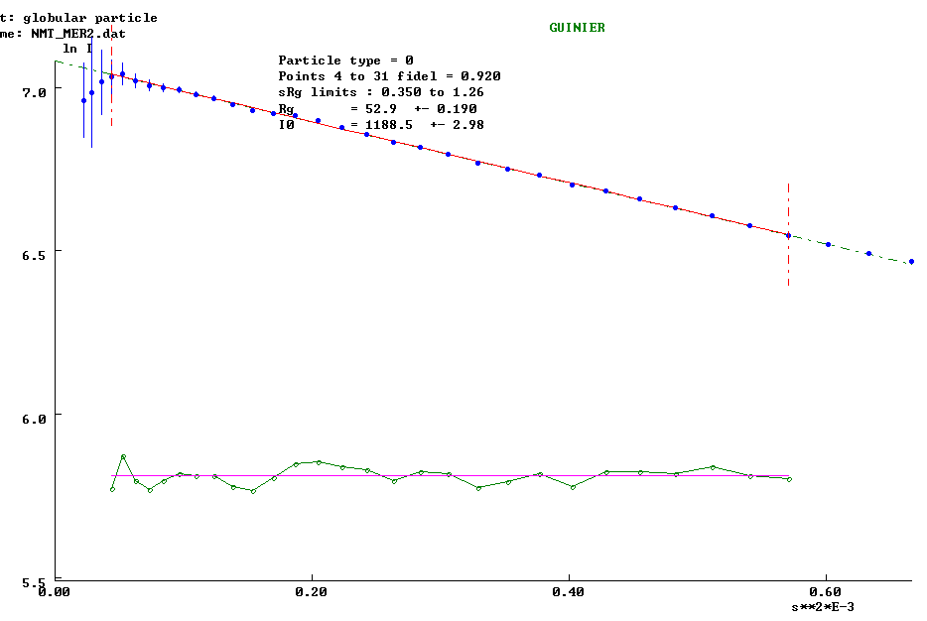
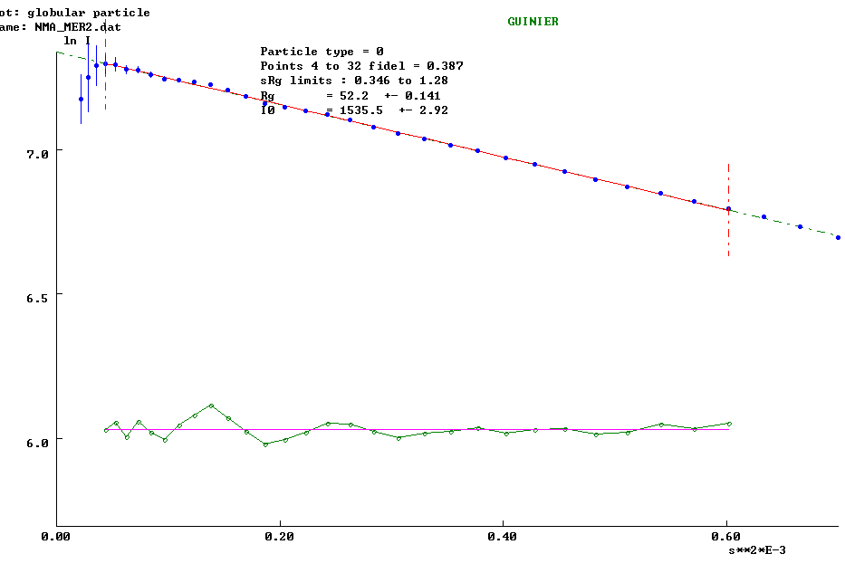
Guiner Plot: Env w/ Glycan is bigger
W/ N160 GLYCAN, Rg = 52.9 A
(DLS Rhyd estimate: 68 A)
W/OUT N160 GLYCAN, Rg = 52.2 A
(DLS estimate: 67 A)
Notes:
Guiner: log scattering intensity vs scattering angle^squared;
Rg - Average of square center-of-mass distances in the molecule
I(0) is intensity measured at 0 angle (q=0), here it’s s, represents number of electrons in the scatterer, unaffected by particle shape and good for MW determination
At high q values -> shape info. It is critical that the plot be linear in the q range of q less than q_{max}=M/R_{g}, where q_{max} is the upper q end-point of Guinier plot and M is typically 1.3 for globular protein.

Slide 22
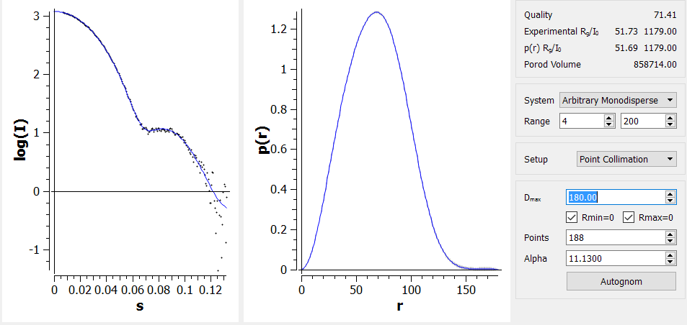
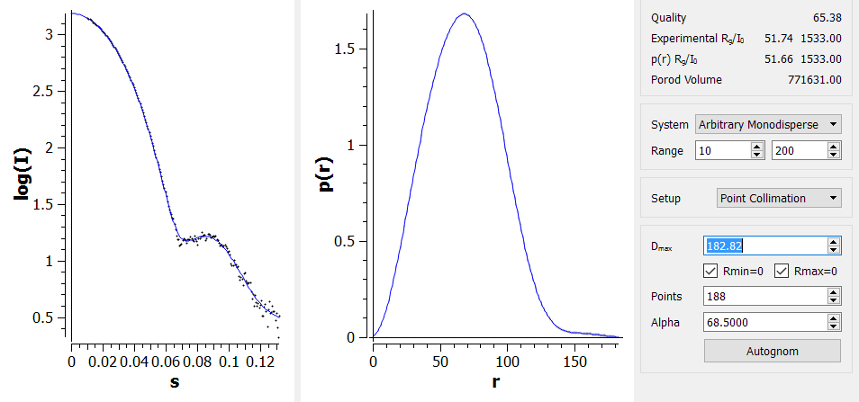
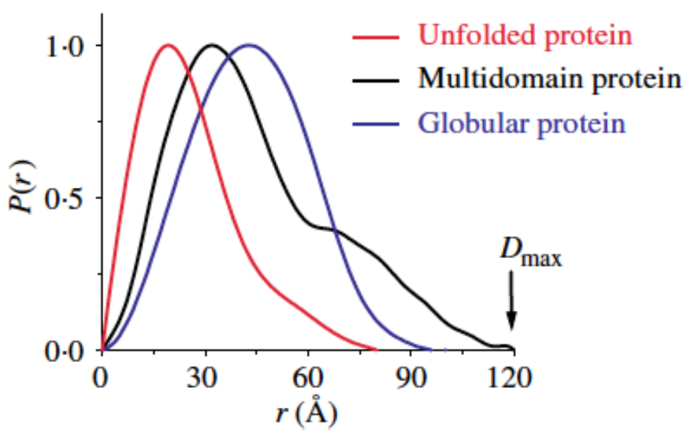
Pair-Distribution Function P(r)
I(q) vs q scattering curve is Fourier transformed into real space
Histogram of inter-atomic distances
Removal of glycan does not affect structure
N160 GLYCAN
W/OUT N160 GLYCAN
Notes:
I(q) scattering curve is Fourier transformed into real space
D-max – maximum dimension of particle in solution
W/ glyc:530 kDa w/out 482 kDa. Using Porod volume. But try through I(0), or water scattering.

Slide 23
Outline
Glycosylated KNH1144 SOSIP Env homology model
Expression and Purification
Biophysical characterization:
Dynamic Light Scattering (DLS)
Thermal stability
Negative Stain Electron microscopy (EM)
Small Angle X-ray Scattering (SAXS)
Antigenicity characterization
Bio-Layer Interferometry (BLI)
Notes:
So structures are identical. These could serve as vaccine antigens! Must check if antigenicity is the same!

Slide 24
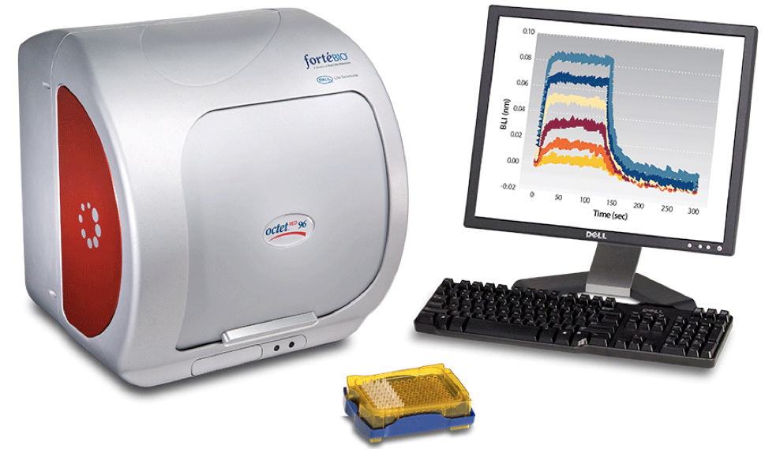

Bio-Layer Interferometry (BLI) for antigenicity screening
Does the presence of N160 glycan change neutralizing antibody binding to the V1/V2 epitope?
http://www.bio-protocol.org/attached/image/2015021.jpg
Notes:
Assay binding buffer – 1% BSA, 0.03% T-20 and 0.02% NaAz, 100rpm, 30C, regeneration in
1M glycine (pH=2.5); , All sosips at concentration of 125 nM.

Slide 25


Monitoring the Interference Pattern vs. Time Provides Kinetic Data on Molecular Interactions
100%
Relative Intensity
ℓ = Distance between two reflecting surfaces
0
Wavelength (nm)
Intensity _{λ} =ƒ(λ, ℓ)
Function of density and optical thickness
nm shift
Time
http://www.fortebio.com/interactions/
Notes:
Captures anti-human IgG FC, nAb will bind to it. Then associate with trimer, and dissociate in buffer.
Wite light is directed into the fiber. Two beams will be reflected to the back end. The first beam comes from the tip as a reference. The second light comes from the molecular layer.
The Octet will monitor change in wavelength shift over time. This real-time binding measurement can be used to calculate on and off rates, and ultimately concentration by plotting rates against concentration.
The difference of two beams will cause a spectrum color pattern as shown here. The phase is a function of the molecular layer thickness and corresponding to the number of molecules on the tip surface.

Slide 26

BLI: N160 Glycan is essential for V1/V2 epitope recognition by NAbs PGT145, PG16 and PG9
2G12
2G12
PGT121
PGT121
VRC01
PGT145
VRC01
17b +CD4
17b +CD4
17b
PGT145
PG16
PG16
PG9
17b
2F5
2F5
PG9
Notes:
2G12 – recognizes high-mannose glycan patch adjacent to CD4 binding site
PGT121/6 – base of V3, esp glycans 301, 332 (most potent binder, removal of glycan increases binding) (light pink)
PGT145, PG9 and PG16 - v1/v2 – binding up (no surprise) (cherry)
2F5 MPER of gp41 (end is cut off, so no binding)
VRC01 – CD4 bs – removal of glycan results in tighter binding
17b – binds to trimer only after CD4-induced conf changes
b12 – CDRH3 loop on CD4 binding site (not shown, but much much higher in KNH than in other isolates) (yellow)
EVOLUTION IN ACTION

Slide 27

PGT 145
17b
PGT121
Notes:
PGT 145, 17b, pgt 121, pg16. Removing glycan exposes pgt121 epitope.

Slide 28

Conclusions
N160 glycan slightly increases Env thermal stability (Tm)
However, reduced protein expression
N160 glycan is necessary for V1/V2 epitope-binding nAbs
Guttman et al., 2015

